Slide 1
ICU Mortality Prediction using Age and ICU Admission Serum Lactate
Abdelrahman Senosy

Slide 2
POPULATION
ICU patients in mimic3_demo dataset
Each ICU stay will be considered for patients having multiple stays whatever they are in the same hospitalization or not.
Total ICU stays included were 60 only
Excluded stays were because either age is not known or no lactate level recorded or it was after 24 hours of admission.

Slide 3
OUTCOME
Death of the patient during the ICU stay
I have taken it from HOSPITAL_EXPIRE_FLAG in ADMISSIONS table.
As it is recorded for the admission not the ICU stay, I needed to adjust the analytic dataset to assign the flag for the last ICU stay only for patients having multiple stays in the same admission.

Slide 4
PREDICTORS
AGE on admission:
Extracted from the admissions table and Calculated just like the practice project
Serum Lactate Level admission to ICU:
Defined as the first serum lactate result after INTIME of the ICU STAY provided that it is done within 24 hours of admission to ICU. So, stays that have first lactate result after 24 hours were excluded as it cannot represent the patient condition on admission.
Extracted from the lab events table using the guidance of d_labevents table to get the itemid of serum lactate

Slide 5
PREDICTORS (CONT.)
To apply the definition of the admission lactate predictor I did the following steps:
Calculated the time difference between CHARTTIME of the result and INTIME of the ICU STAY
Excluded the negative results (i.e. the results before the ICU STAY INTIME)
Filtered the results to include only those with minimum time difference (the nearest to INTIME)
Excluded results with time difference more then 86400 sec (24 hrs)

Slide 6
PATIENTS AND CIRCUMSTANCES
This model use 2 predictors only that are very easy to be available for any patient on ICU Admission: the age and the first serum lactate result.
This works for any patient admitted to ICU whatever the diagnosis, gender, history of previous hospitalization or ICU admission.

Slide 7
ANALYTIC METHODOLGY
Logistic Regression Model (Binomial Family)
Train/Test Validation (70/30)

Slide 8
PREDICTION MODEL TYPE
Indeed, mortality prediction has so many clinical, operational, research and financial uses.
For this model it is very simple and easy to interpret and can be used for any purpose by any staff either clinical or non-clinical.
For example, it can be used operational for KPIs monitoring to assess ICU performance , as it is known that expected mortality is taken in account while actual mortality in ICU is being monitored.

Slide 9
IMPLEMENTATION
It can be easily included in the HIS Clinical Decision support as it depends of simple numerical values that are available most of the time in the EMR and not depending on any subjective assessment.

Slide 10
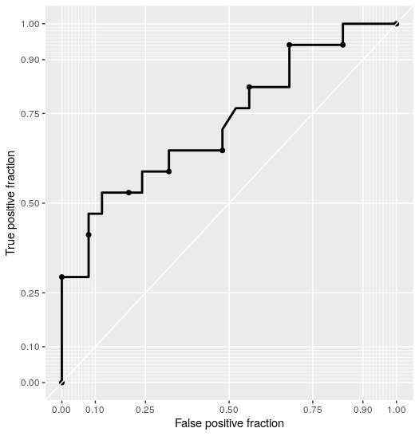
MODEL EVALUATION (QUANTITATIVE)
With repeating the model building, AUR is ranging from 64-78
ROC of applying the model to Training Data

Slide 11
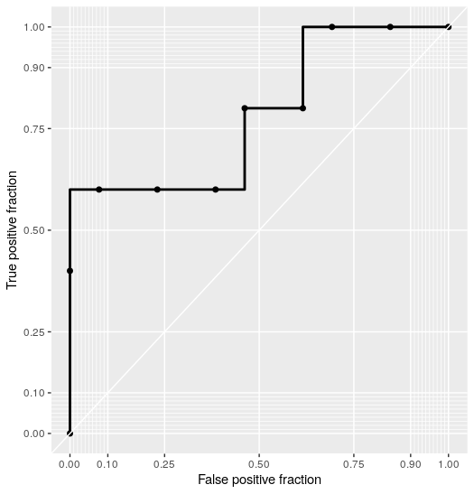
MODEL EVALUATION (QUANTITATIVE)
With repeating the model building, AUR is ranging from 78-95!
This looks widely variable results, despite looking good numbers, that need more validation or using other advanced models.
ROC of applying the model to Testing Data

Slide 12
MODEL EVALUATION (QUALTITATIVE)
The simplicity of the model is its both main limitation and advantage.
That is because it does not take many important variables in account, like cause of admission, gender, underlying cause of hyperlactatemia ..etc
So, it could be more safe to use it for non-clinical purposes first. It cannot be extended to clinical use before extensive validation on different populations.

Slide 13
FULL CODE AND RESULTS ARE HERE
https://drive.google.com/file/d/1Pt1gujIdh-rBEa5zL7sX6odB5ZWthkDq/view?usp=share_link

